Slide 1
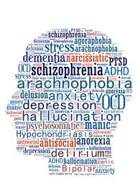
Mental Health – Analysis

Slide 2

Group members:
Farah Hayat
Patricia Colomer
Prerna Dutt
Vivian Nnadozie

Slide 3
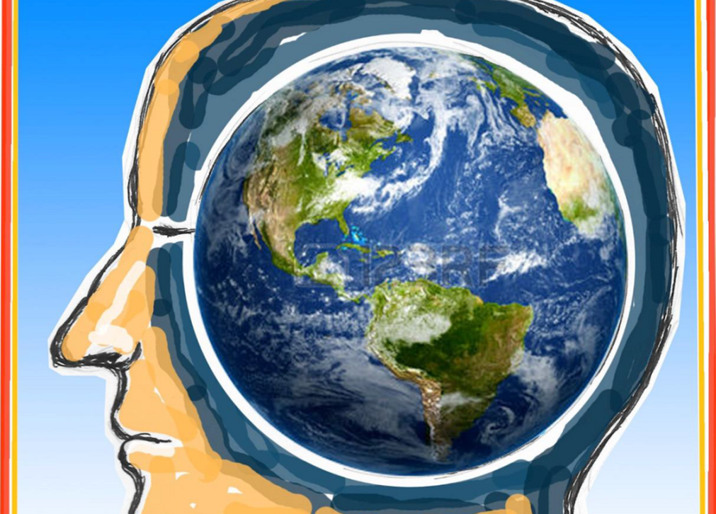
Motivation

Slide 4
“People with severe mental health conditions die prematurely – as much as two decades early – due to preventable physical conditions. Despite progress in some countries, people with mental health conditions often experience severe human rights violations, discrimination, and stigma.” - WHO
Millions of people worldwide have mental health conditions and an estimated one in four people globally will experience a mental health condition in their lifetime. Almost one million people die due to suicide every year, and it is the third leading cause of death among young people. Depression is the leading cause of years lost due to disability worldwide. Mental health problems, including alcohol abuse, are among the ten leading causes of disability in both developed and developing countries.
The economic cost of mental health problems is vast, while reasonable investment in mental health can contribute to better mental health for people. Poor mental health is both a cause and a consequence of poverty, compromised education, gender inequality, ill-health, violence and other global challenges. It impedes the individual’s capacity to work productively, realize their potential and make a contribution to their community.
We wanted to analyse the prevalence of the most common mental health disorders worldwide and its impact on life expectancy.

Slide 5

Objectives

Slide 6
Analyse the prevalence of mental health disorders across different countries from 1990 to 2019 and its impact on life expectancy.
Train a machine learning model to predict the years lost in a country as a result of the prevalence of various mental disorders and factors that contribute to it across various countries in the world.
Train a machine learning model to predict the prevalence of different mental disorders in future years in various countries across the globe.

Slide 7
Methodology
Problem Statement
Data Pre-processing
Model Building
Analysis
Summary
User Interface

Slide 8

Challenges

Slide 9
Initially not knowing what we were looking for and therefore cleaning/arranging the data several times, to achieve cleaned data that was useful for our analysis.
Machine learning models: selecting the best model for our data, learning new models that could potentially perform better with the data we were handling.
Achieving accuracy on ML models, making sure the models were not overfitting/not performing adequately.

Slide 10

Technologies used

Slide 11
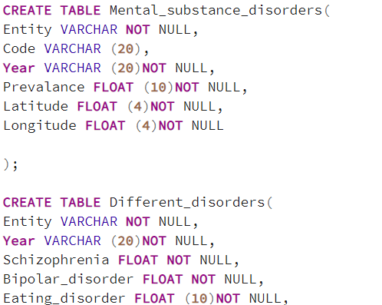
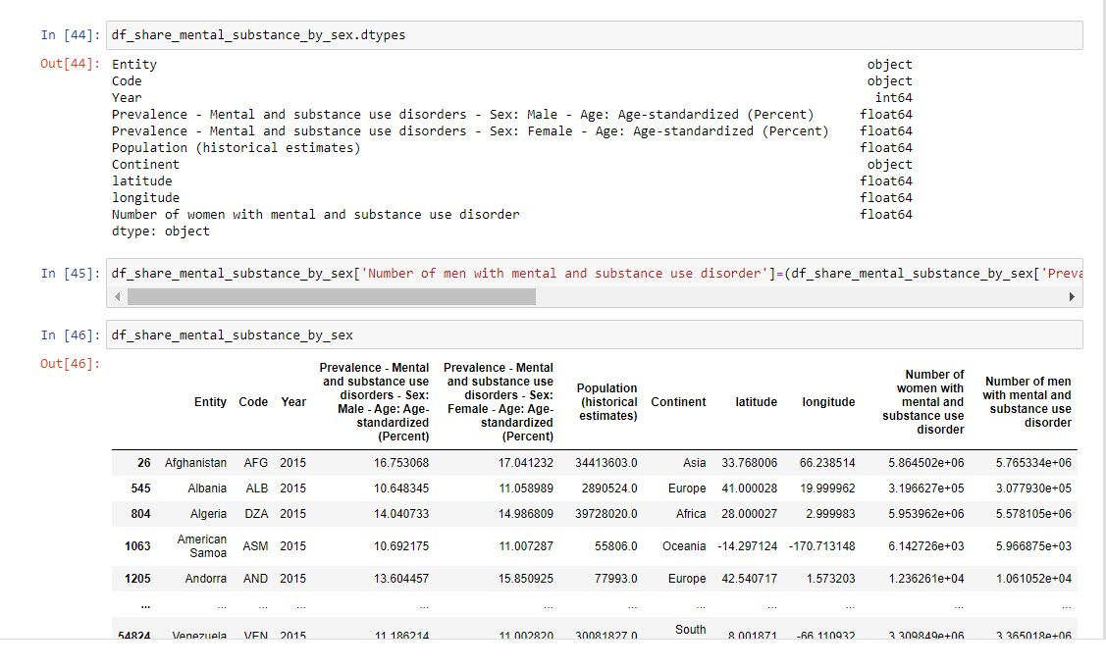
Python (pandas, matplotlib, numpy)
SQL

Slide 12
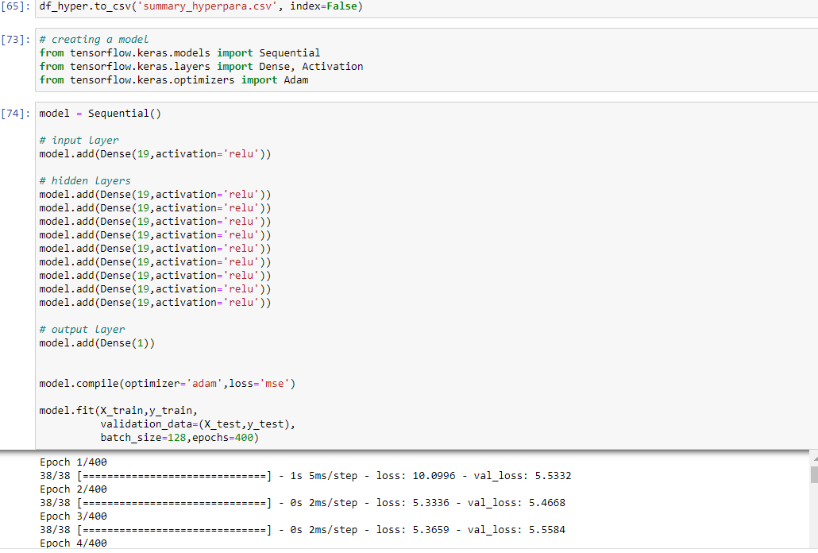
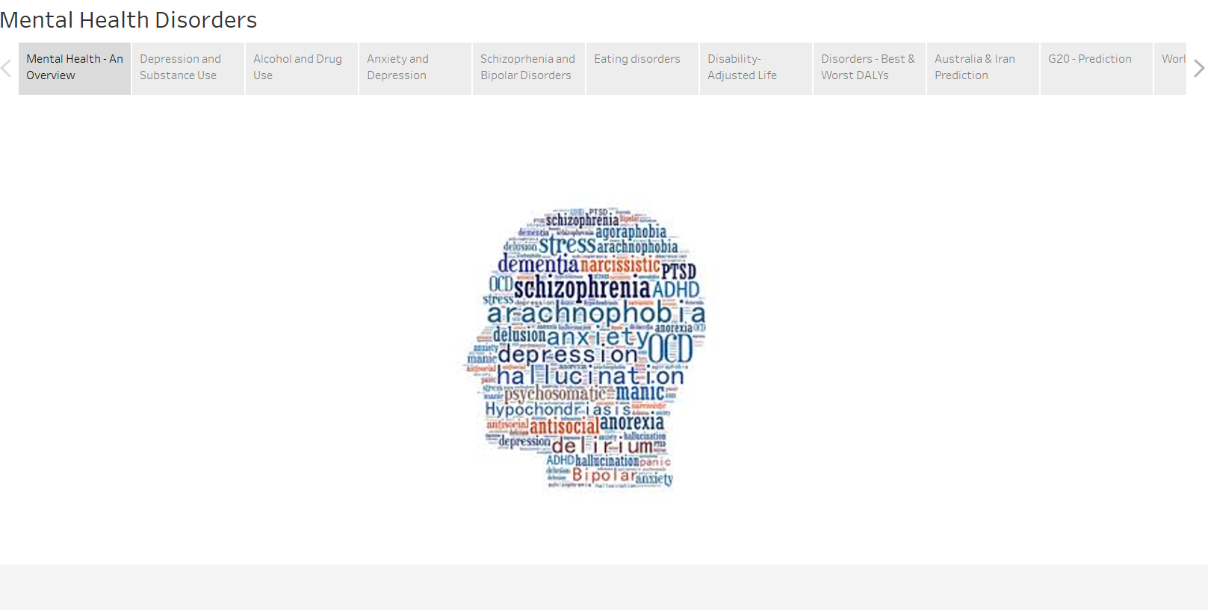
Machine Learning: sklearn, keras, etc
Tableau

Slide 13

Machine Learning

Slide 14
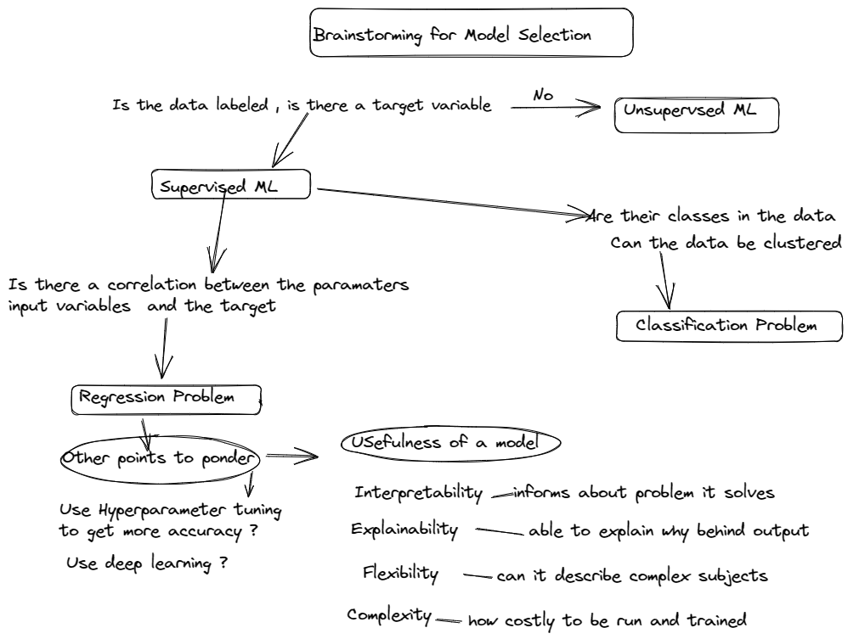

Slide 15
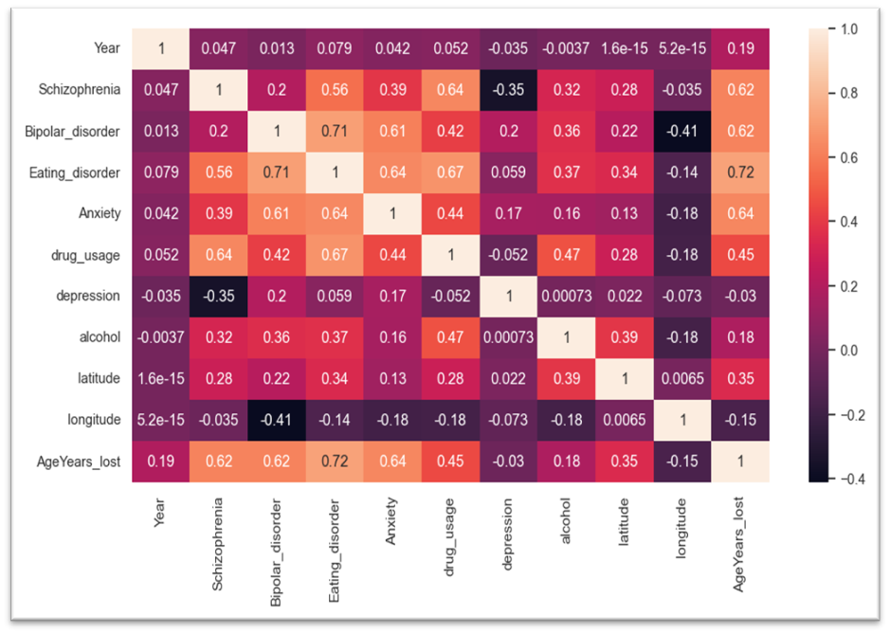
Correlation Matrix set up to assess the correlation : At least 5 of the parameters strongly correlated .
Feature Selection: Used input features showing better correlation and dropped the parameters country , latitude and longitude as correlation appeared to be low

Slide 16
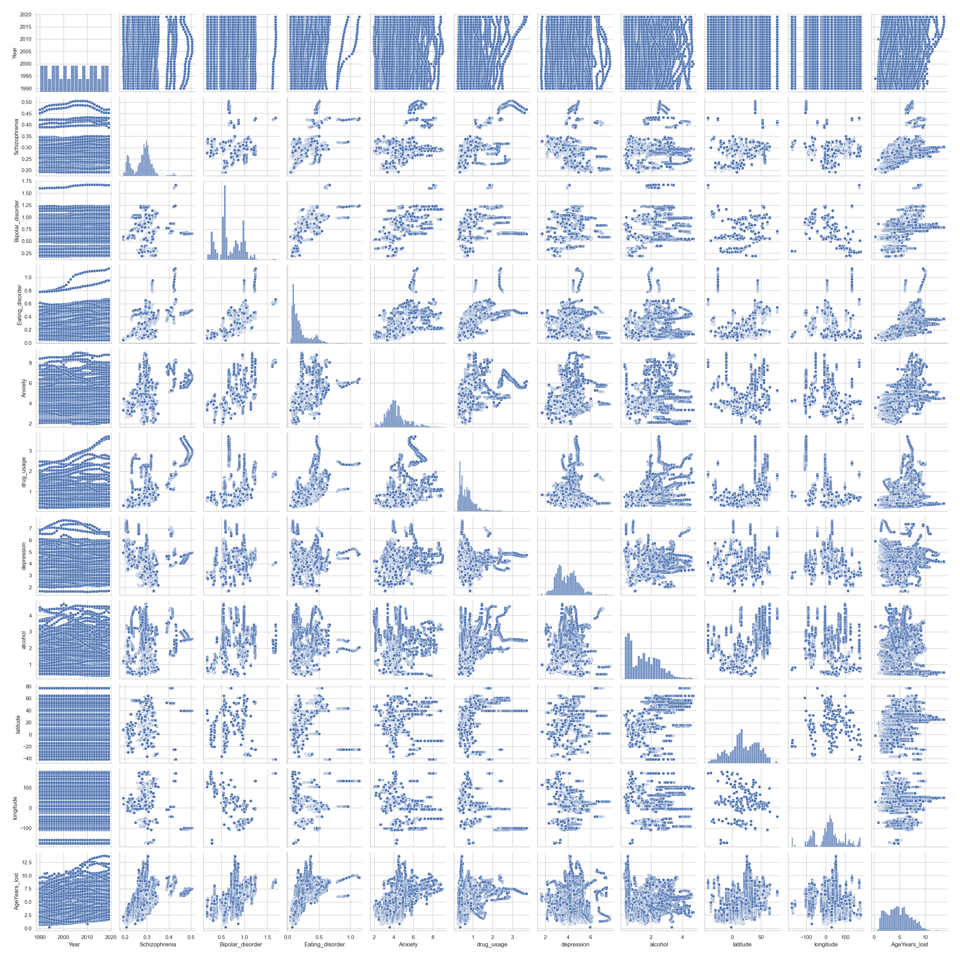
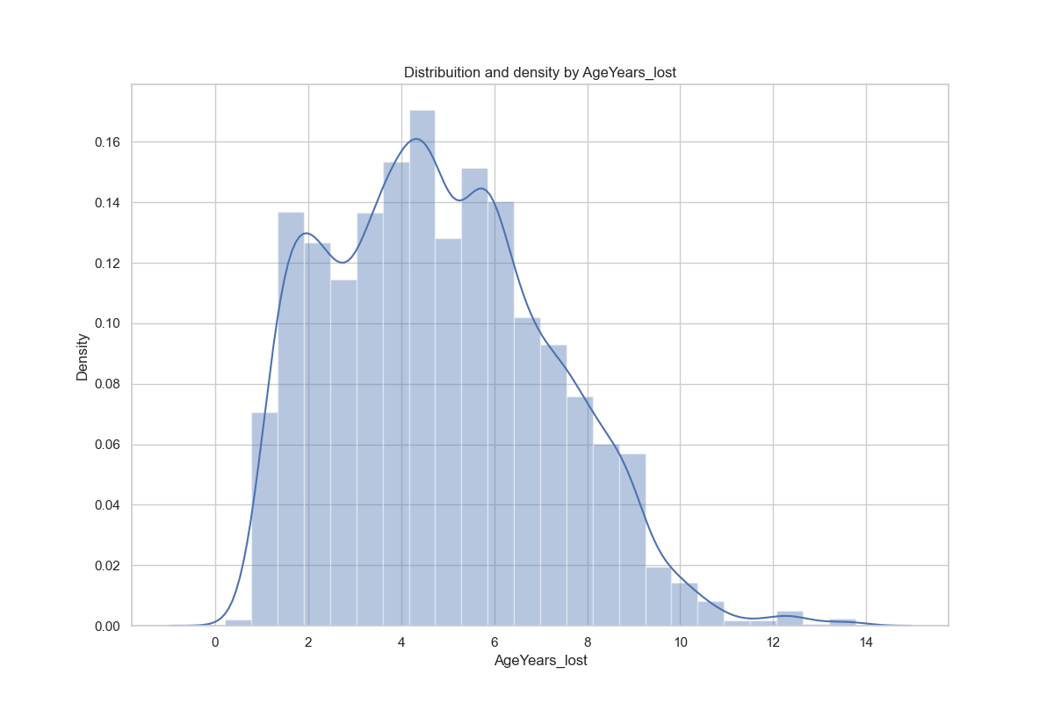
Scatter Plot and Histograms used to see the correlation between the input and output variable

Slide 17
Approach followed : Supervised ML
Regression
Machine learning Model to predict Disorder in future years amongst the population and also vs gender
ML Model to predict Years_Lost based on multiple parameter (diseases) in the population across various countries
Applied label encoder to convert data into numeric as our country column was categorical
Experimenting with different models
LR
KNN
XGBoost
Decision Tree
Random Forest
Deep Learning :Keras Model
HyperParameter Tuning

Slide 18
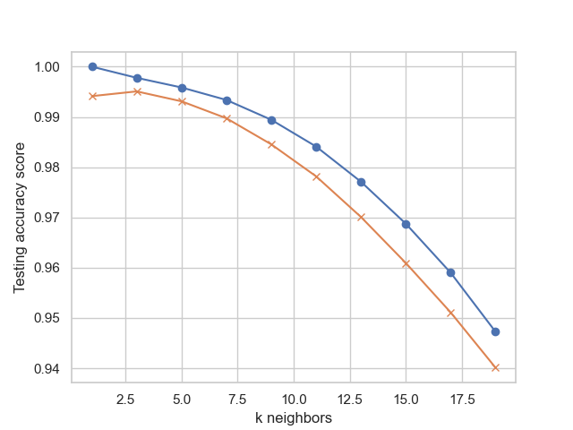
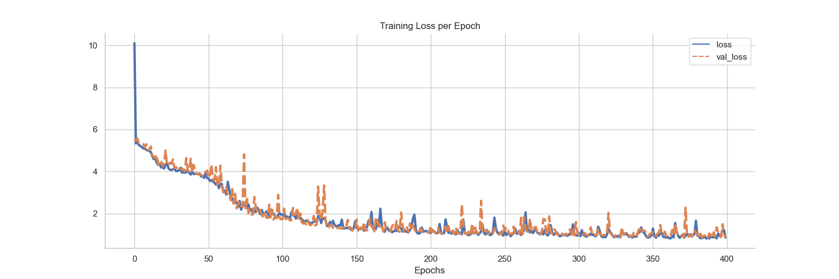
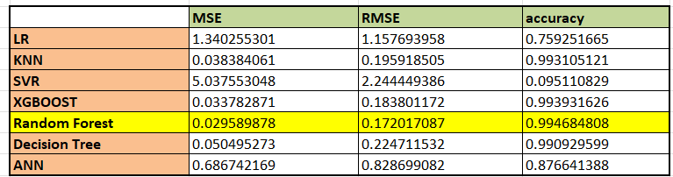
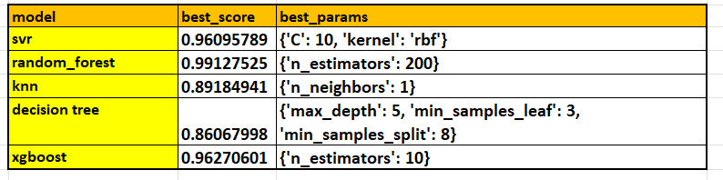
Some of our ML models:
Results

Slide 19
Experimentation with models
Linear Regression : Benchmark Model only – Only got 75% accuracy on one representation of Data ( Catch / underlying assumption linear correlation, may not be the case).
KNN : New point/sample data assigned value based on how close to points in training set.(Catch/Assumption: data points/instances which exist in close proximity to each other are highly similar).
Decision Tree : Handle both continuous , categorical variable. No feature scaling required . Handles non-linear parameters efficiently.
Random Forest : It is capable of handling large datasets with high dimensionality. It enhances the accuracy of the model and prevents the overfitting issue.
SVR : Testing this in case our correlation is not linear. SSVR can deploy non-linear kernel and allows for non-linear fitting problems.
XGBoost : Faster than Adaboost. Trains many models in gradual, additive, parallel manner. “Boosting” or improving a single weak model by combining it with several other weak models in order to generate a collectively strong model.
HyperParameter Tuning: For Model Optimization . We are passing predefined values for Hyperparameters to the GridSearchCV function. To arrive at optimized vales of hyperparameters to maximise the model’s predictive accuracy.
Deep Learning –ANN : To learn and model non-linear and complex relationships where input factors can be correlated. Useful for extracting insights from data however we need insight into decision making process as this functions as black box and increased amounts of computing power.

Slide 20
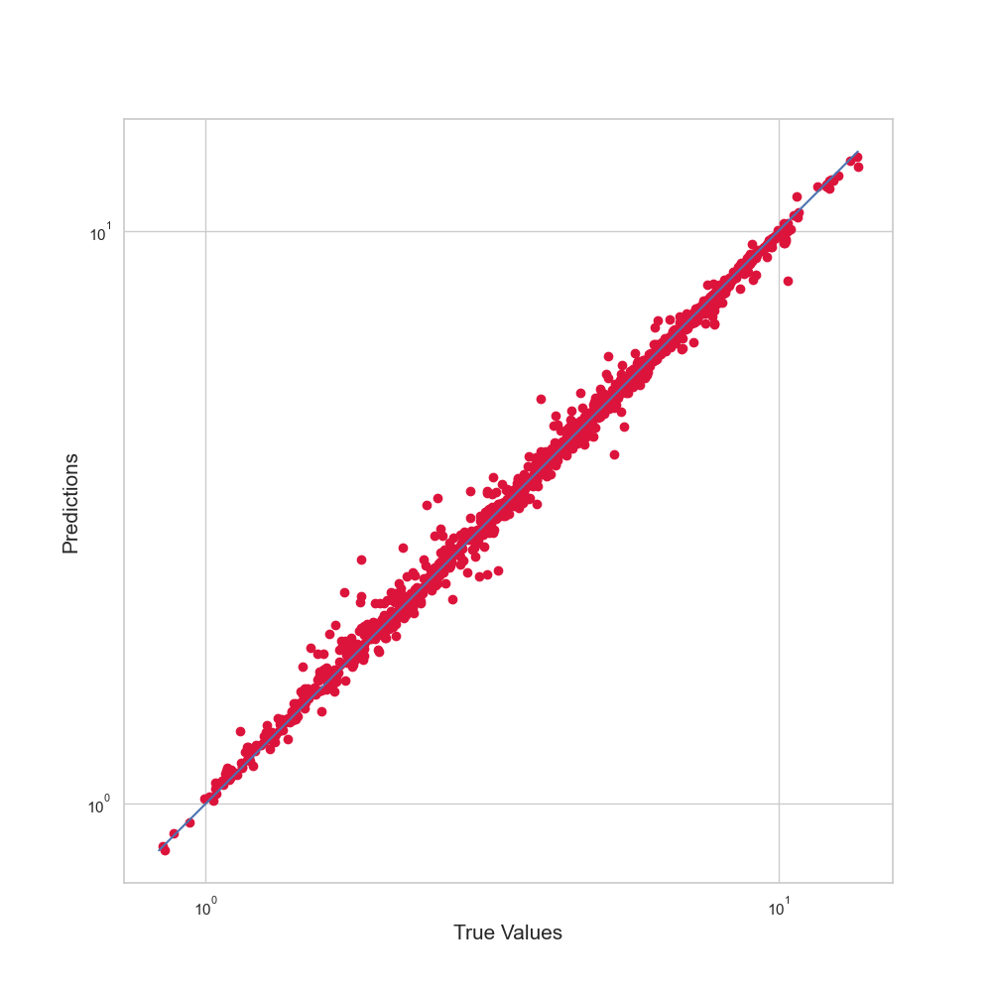
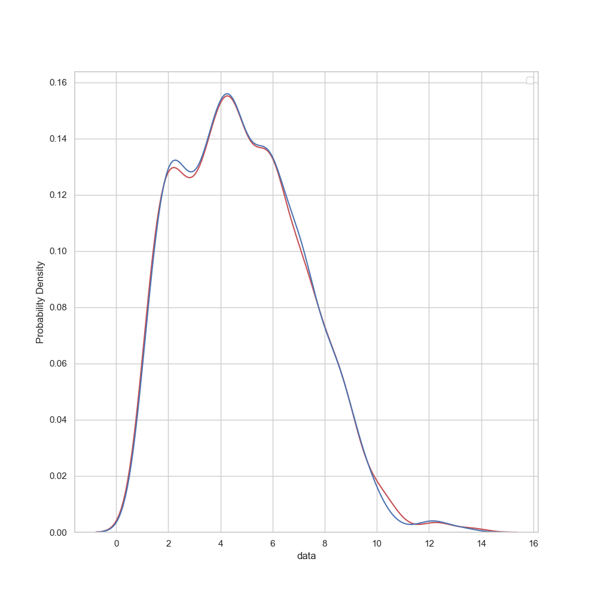
Random Forest: Our choice
We tried hyperparameter tunning to get best model fit as well as tried different models to find which algorithm is giving better accuracy. We found that random forest is the better choice amongst all algorithms considering the accuracy along with factors such as complexity , cost , speed are taken into account.
It can handle both categorical and continuous variables.
It is capable of handling large datasets with high dimensionality.
It enhances the accuracy of the model and prevents the overfitting issue
Robust to outliers
Red: actual values
Blue: predicted values
KDE Plot

Slide 21

Analysis

Slide 22
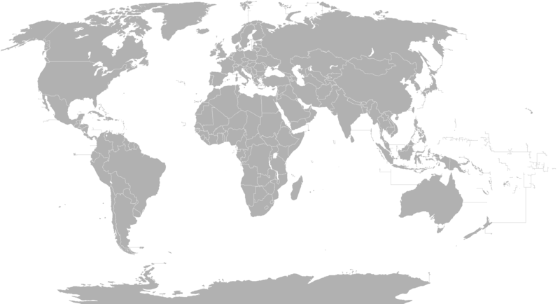
We have analysed the mental health records of 210 countries from 1990 to 2019 for the most prevalent mental health disorders:
Anxiety
Depression
Alcohol Use
Drug use
Eating disorder
Bipolar disorder
Schizophrenia
We have looked at the effects that these mental health disorders have on life expectancy and predicted what the mental health will be like in the future

Slide 23
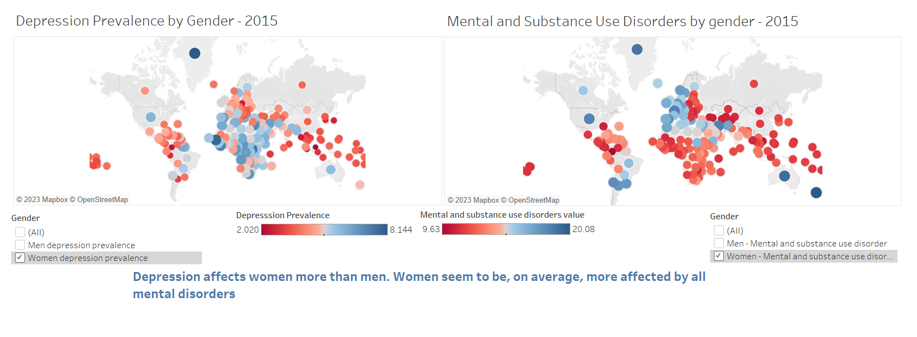

Slide 24
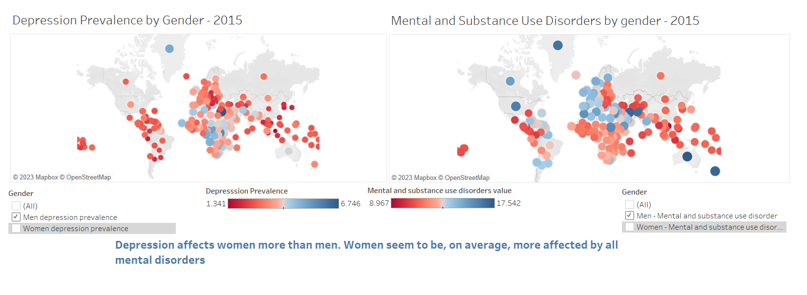

Slide 25
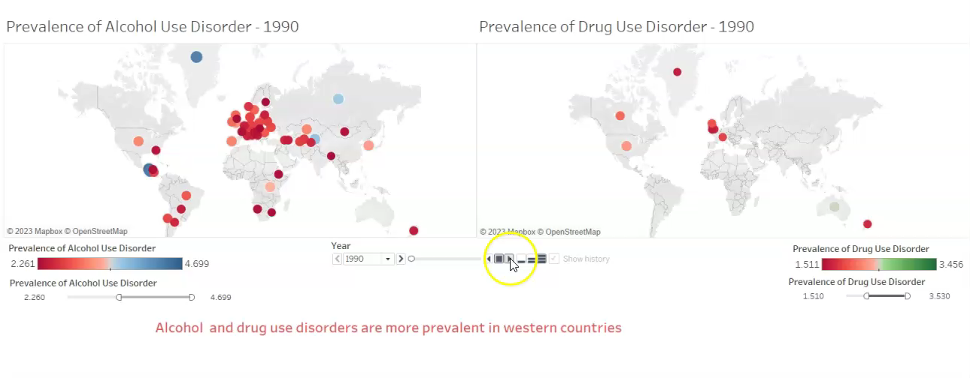
Prevalence of Alcohol and Drug Use disorders from 1990 to 2019

Slide 26
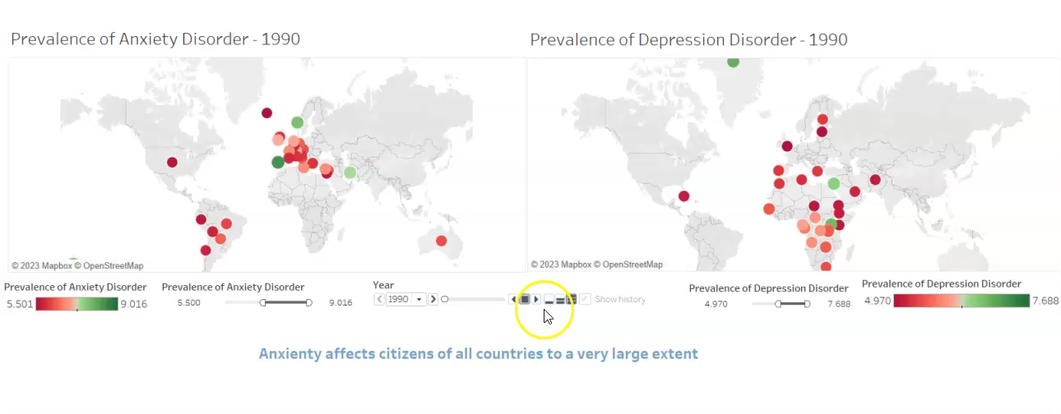
Prevalence of Anxiety and Depression from 1990 to 2019

Slide 27
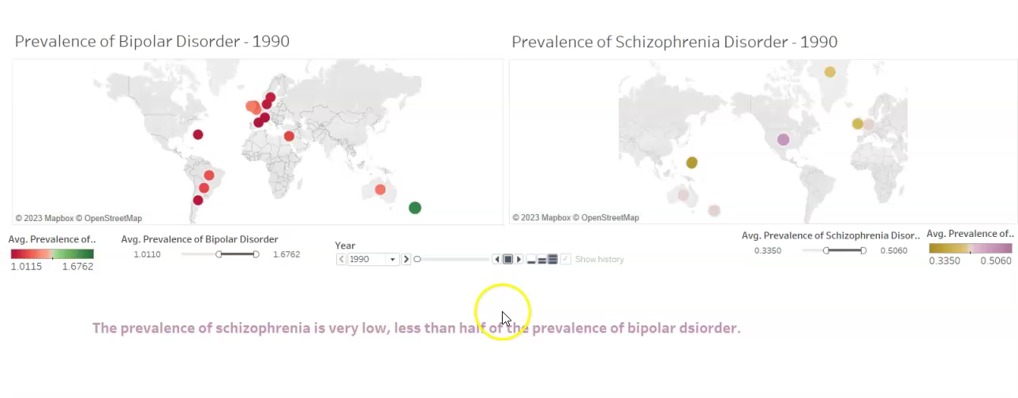
Prevalence of Bipolar disorder and Schizophrenia from 1990 to 2019

Slide 28
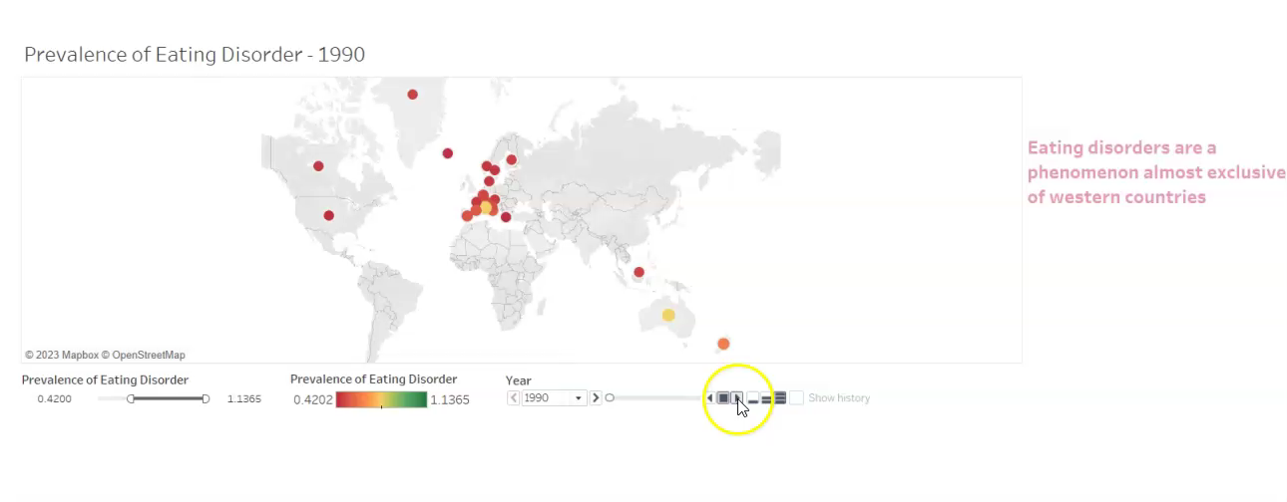
Prevalence of Eating disorders from 1990 to 2019

Slide 29
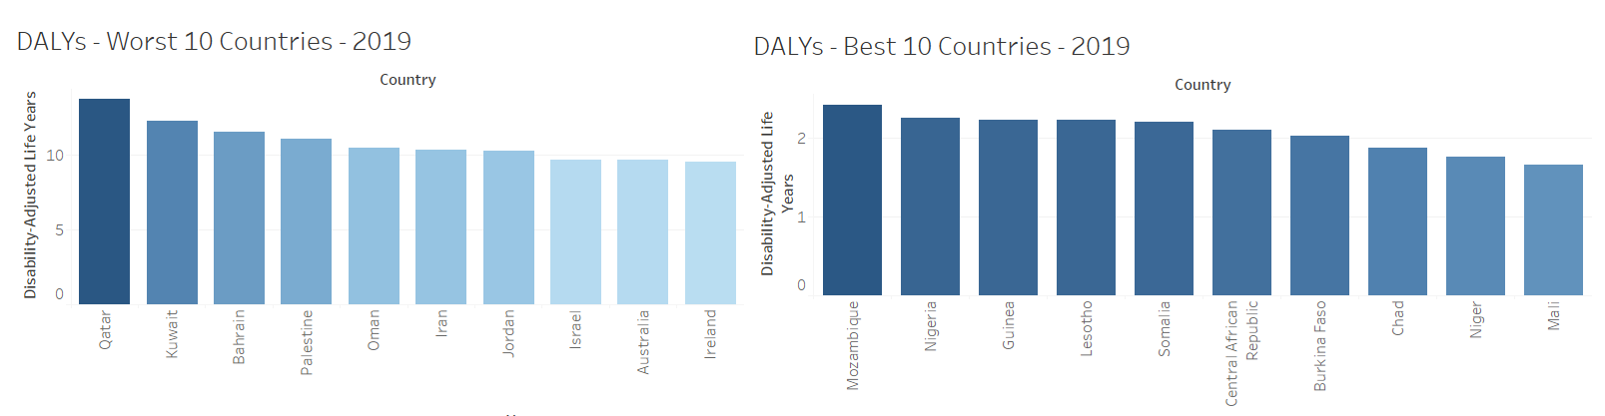
One DALY represents the loss of the equivalent of one year of full health. DALYs for a disease or health condition are the sum of the years of life lost to due to premature mortality (YLLs) and the years lived with a disability (YLDs) due to prevalent cases of the disease or health condition in a population.

Slide 30
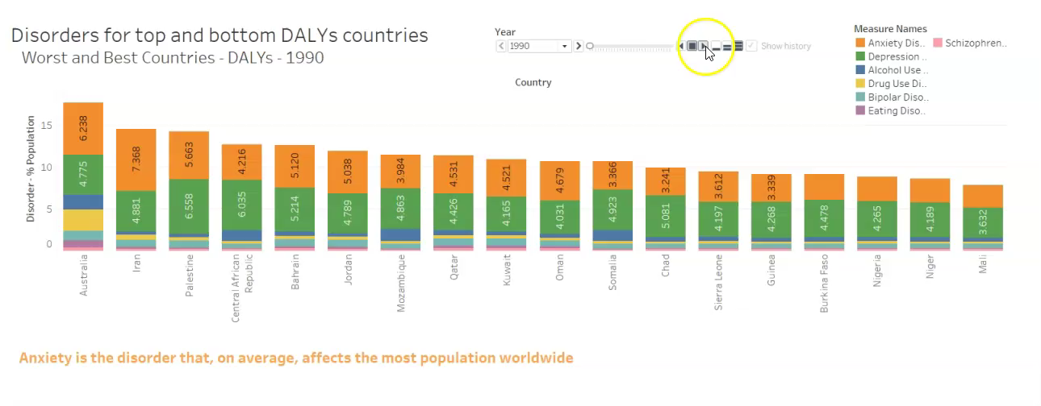
Evolution of mental health disorders from 1990 to 2019

Slide 31

Mapping the future of Mental Health

Slide 32
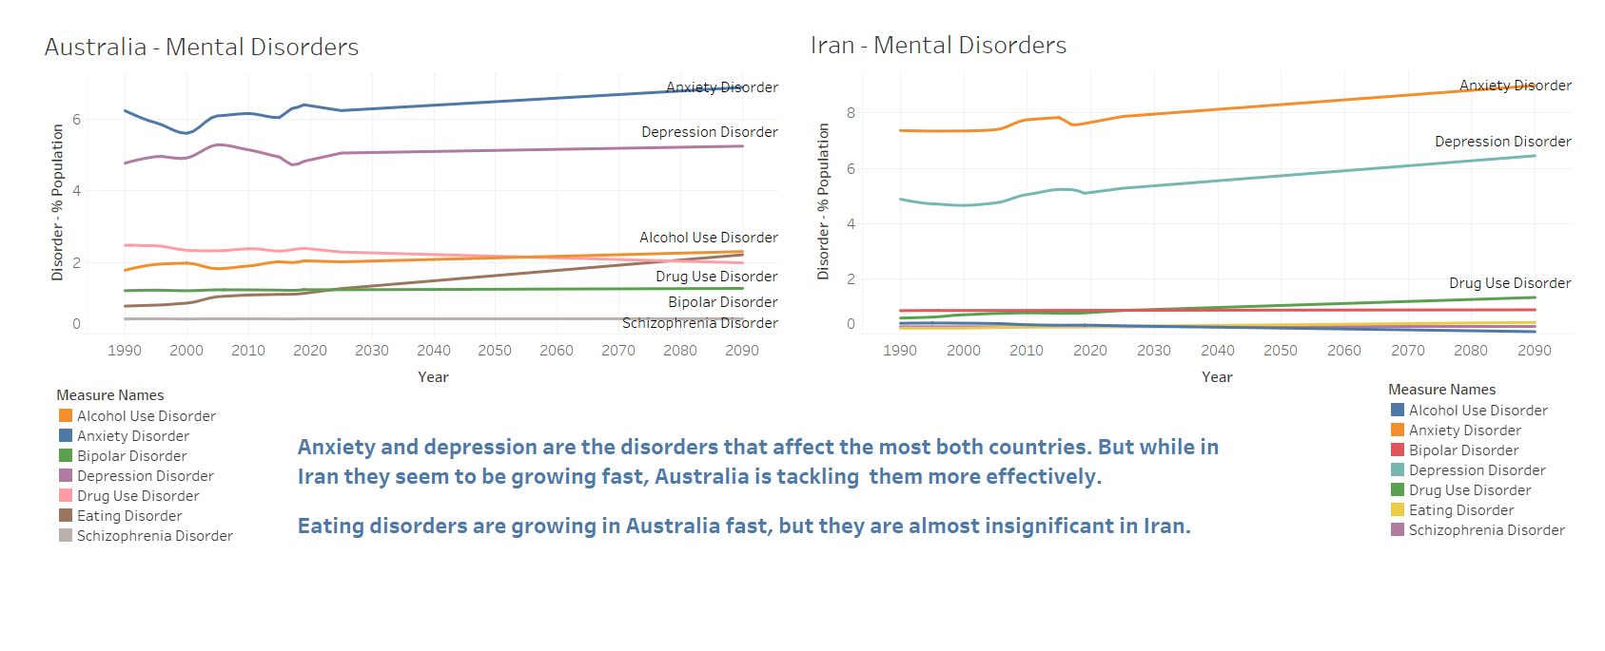

Slide 33
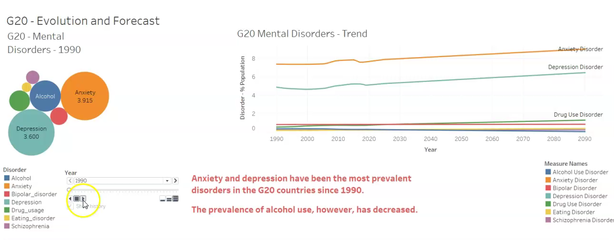
The future for G20 Countries

Slide 34
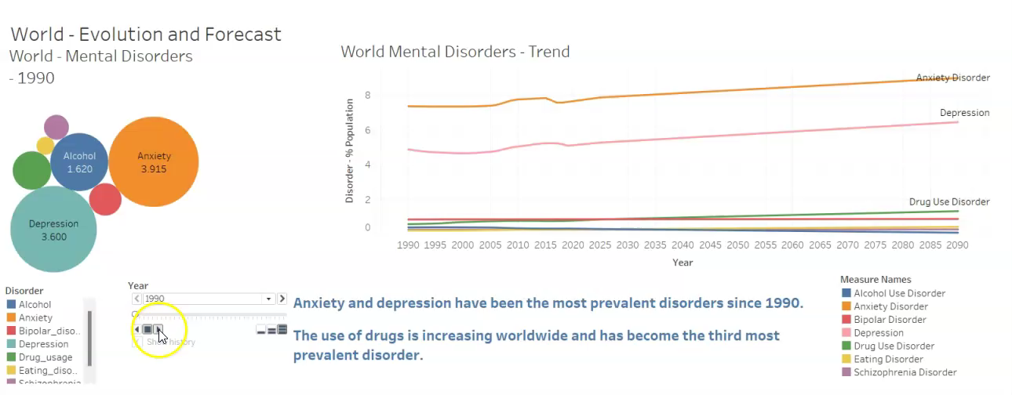
What will the world look like in the future?

Slide 35
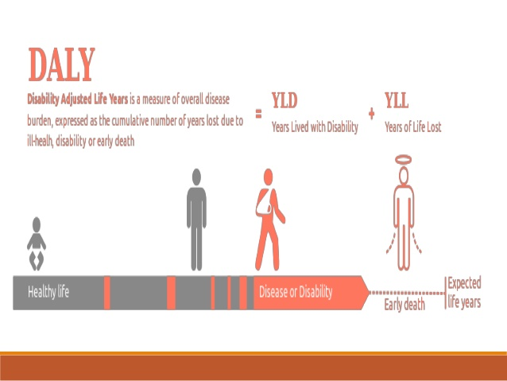
Predicting the years lost due to mental health disorders

Slide 36
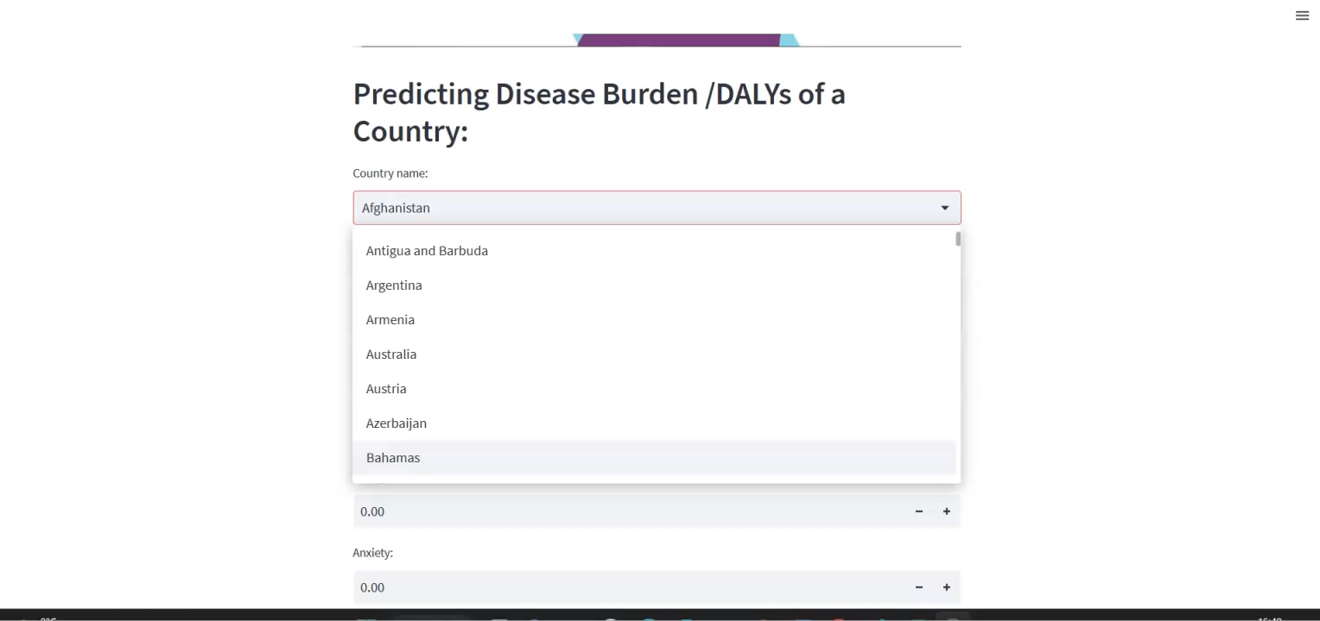

Slide 37


